Slide 1
The Lady, or the Tiger?
Frank R. Stockton

Slide 2
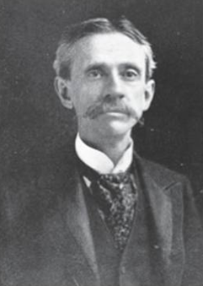
The Lady, or The Tiger?—Frank Stockton
Meet Frank R. Stockton (1834-1902)
At the height of his success, Frank R. Stockton was considered a major literary figure in the United States, second in importance only to Mark Twain.
Stockton’s body of work fills twenty-three volumes and includes stories, novels, and nonfiction.
Yet today, this writer is known primarily for his story, “The Lady, or the Tiger?”
The story created a stir at the time it was published, as well as afterward; it was later turned into an operetta, a play, a movie, and a recording.

Slide 3
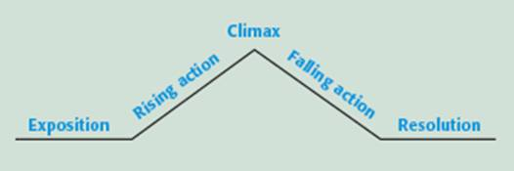
Dramatic Plot Structure
A literary plot has five elements:
Exposition
Rising Action
Climax
Falling Action
Resolution

Slide 4
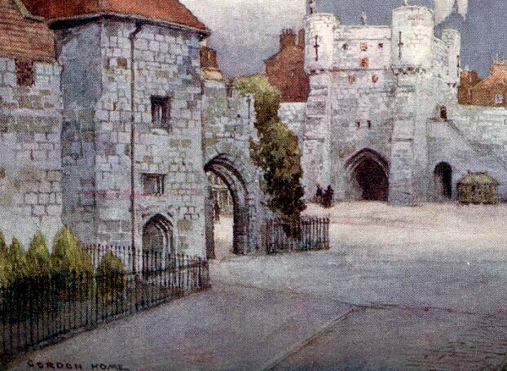

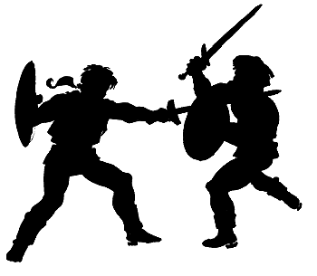
Dramatic Plot Structure
Exposition During a plot’s exposition, the author gives background information about the story and introduces the story’s characters and setting. The exposition also introduces the main conflict.
Rising Action Rising action is the series of events that lead up to the climax, or most dramatic moment, of the story.
Climax The climax is a story’s most dramatic and revealing moment. It usually comes near the end of a story and satisfies the reader’s curiosity about what happens.

Slide 5
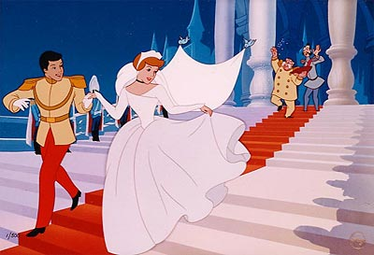
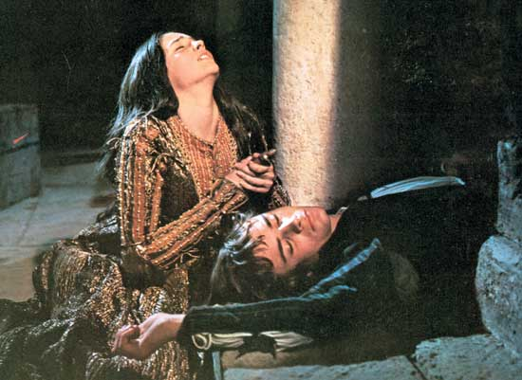
Dramatic Plot Structure
Falling Action The falling action follows the climax and describes the results of the climax.
Resolution The resolution, or denouement, comes at the end of the falling action.
“The Lady, or the Tiger?” has a trick ending—readers must supply the resolution.

Slide 6
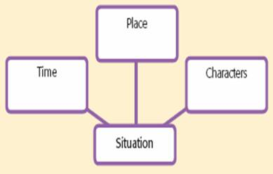
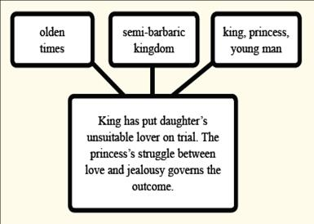
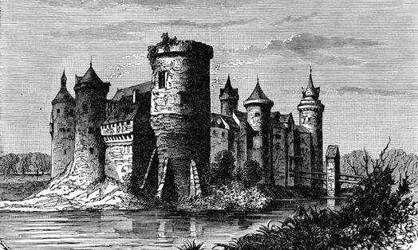
The Lady, or The Tiger?—Frank Stockton
Setting

Slide 7
Dramatic Plot Structure
Conflict
Most plots develop around a conflict, or struggle between two or more forces in a story.
External conflict is the battle between a character and an outside force—nature, society, fate, or another character.
Internal conflict is the battle within the mind of a character who is torn between different courses of action.

Slide 8

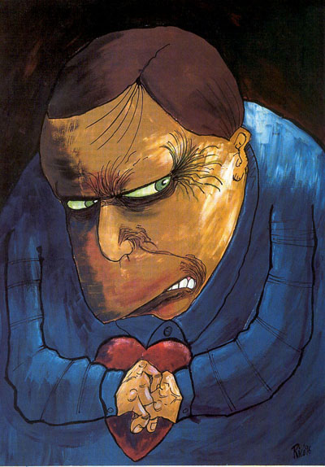
The Lady, or The Tiger?—Frank Stockton
Connecting to the Story
Would you trust your life to a friend?
Before you read the story, think about the following questions:
• Which is a stronger emotion—love or jealousy?
• How completely can one person ever know and understand another?

Slide 9
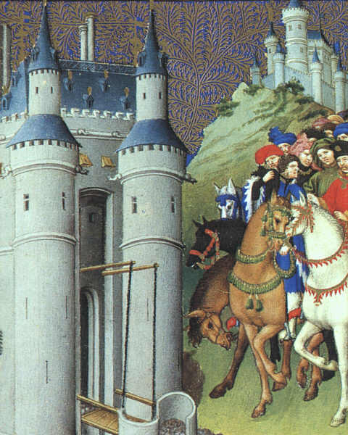
The Lady, or The Tiger?—Frank Stockton
During the Middle Ages in England, guilt or innocence was decided through a practice known as an ordeal. An accused person was physically tested, and the outcome determined guilt or innocence. The accusers believed that supernatural forces controlled what happened. For instance, in the ordeal by water, the accused person was tied up and thrown into deep water. A person who floated was thought to be guilty; a person who sank was considered innocent. Unfortunately, those who sank often drowned before they could be hauled back up.

Slide 10
The Lady, or The Tiger?—Frank Stockton
BIG IDEA
Matters of Life and Death
As you read this story, notice how the characters value life and death in different ways.

Slide 11

The Lady, or The Tiger?—Frank Stockton
BEFORE YOU READ
READING PREVIEW
Vocabulary
impartial (im pär´ shəl) adj. not favoring one side more than another; fair; An honest judge is impartial.
emanate (em´ ə nāt´) v. to come forth; We never heard any sound emanate from that room.
dire (dīr) adj. dreadful; terrible; Breaking certain rules can have dire consequences.

Slide 12
The Lady, or The Tiger?—Frank Stockton
BEFORE YOU READ
READING PREVIEW
Vocabulary
fervent (fur´ vənt) adj. having or showing great intensity of feeling; passionate; The coach was a fervent believer in practicing every day in order to improve.
novel (nov´ əl) adj. new and unusual; Since that older method seldom works, try a more novel approach.
Vocabulary Tip: Multiple-Meaning Words Many words have more than one meaning. Use context to help determine a word’s correct meaning.
Now it’s time to read the story!

Slide 13



The Lady, or The Tiger?—Frank Stockton
AFTER YOU READ
Why does a life-or-death trial appeal to the king?
The king enjoys putting people at the mercy of a heartless and whimsical fate and uses this cruel spectacle to teach his subjects a lesson.
Why do the king’s subjects enjoy the life-or-death trial?
The uncertainty is exciting.

Slide 14
The Lady, or The Tiger?—Frank Stockton
AFTER YOU READ
Recall and Interpret
(a) In the kingdom described in the story, what happens when a person is accused of a crime? (b) Why do the members of the community support this method?
(a) The accused person must choose between two doors concealing either a tiger that will kill him or a woman who will marry him. Chance governs his choice. (b) They find the trials exciting and entertaining, as well as fair, since the accused made the choice.

Slide 15
The Lady, or The Tiger?—Frank Stockton
AFTER YOU READ
Recall and Interpret
(a) What is the young man’s crime?
(b) Why are his actions considered criminal?
(a) Loving the king’s daughter
(b) His low position in society made him an unworthy suitor.

Slide 16
The Lady, or The Tiger?—Frank Stockton
AFTER YOU READ
Recall and Interpret
(a) What does the princess do when the young man is in the arena? (b) What motive does she have for sending him to his death, and what motive does she have for saving his life?
(a) Gesture toward the right (b) Jealousy; true, unselfish love

Slide 17
The Lady, or The Tiger?—Frank Stockton
AFTER YOU READ
Analyze and Evaluate
Why do you think the story ends with a question instead of an answer?
To invite readers to ponder the conflict between love and jealousy.

Slide 18
The Lady, or The Tiger?—Frank Stockton
AFTER YOU READ
Connect
In what ways is the king’s justice similar to flipping a coin to decide an important question?
In both cases, chance alone determines the outcome.

Slide 19
The Lady, or The Tiger?—Frank Stockton
AFTER YOU READ
LITERARY ANALYSIS
Literary Element
Conflict
What conflicts does the young man have? Are his conflicts internal or external? Support your answers with details from the story.
External: which door to open – possibly facing the tiger
Internal: whether to believe the princess
Why is the princess’s internal conflict so central to the story?
Her decision governs if the young man lives or dies. Your view of her will affect your choice of resolution.

Slide 20
This powerpoint was kindly donated to www.worldofteaching.com
http://www.worldofteaching.com is home to over a thousand powerpoints submitted by teachers. This is a completely free site and requires no registration. Please visit and I hope it will help in your teaching.

